Slide 1
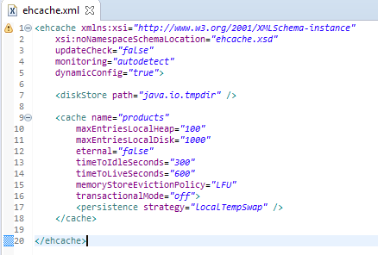
Spring Cache Tutorial with EhCache (Update the Cache)
ehcache.xml providing the caching configuration for individual cache items.
Here we are setting up a cache with name ‘products’. Maximum 100 products will be kept in in-memory [on-heap] store, while maximum 1000 products will be maintained in the DiskStore.
The path specified ‘java.io.tmpdir’ which refers to default temp file path.
A product will be expired if it is idle for more than 5 minutes and lives for more than 10 minutes.
A detailed description of individual properties can be found at - http://www.ehcache.org/ehcache.xml

Slide 2
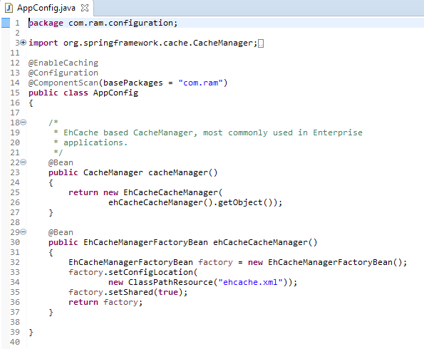
Spring Cache Tutorial with EhCache (Update the Cache)
@EnableCaching [ Used for Enabling Caching support in Spring Application]
@EnableCaching annotation triggers a post processor that inspects every Spring bean for the presence of caching annotations[@Cacheable, @CacheEvict, @CachePut] on public methods. If such an annotation is found, a proxy is automatically created to intercept the method call and handle the caching behavior accordingly.

Slide 3
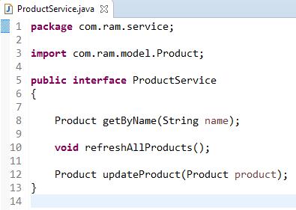
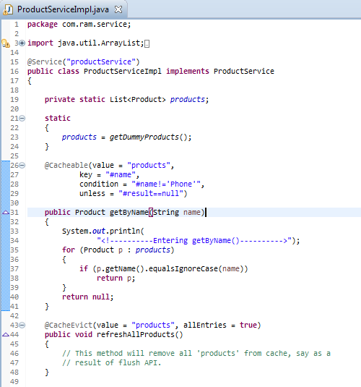
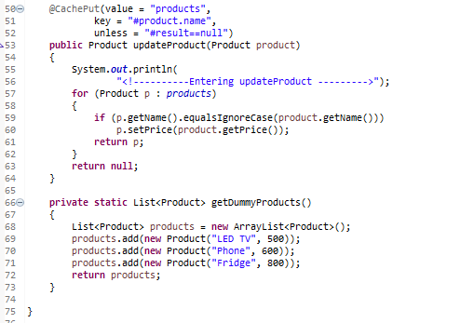
Spring Cache Tutorial with EhCache (Update the Cache)
Products Cache
Key | Value
Key | Value
LED TV | LED TV Object
Fridge | Fridge Object

Slide 4
Spring Cache Tutorial with EhCache (Update the Cache)
@Cacheable [ Used for populating and accessing Cache]
@Cacheable annotation indicates that the result of invoking a method (or all methods in a class) can be cached. A cache itself can be imagined as a key-value based Map.
First time a method annotated with @Cacheable gets called, it gets executed and it’s return value is stored in Cache using a key[method parameter for instance, ]. Next time, if the method gets called using same key[same parameter for instance], the result is returned directly from Cache, method invocation does not take place.
By default it uses the method parameters [product name in this case] to compute the key
@CacheEvict [ Used for removing items from Cache]
@CacheEvict annotation indicates that a method (or all methods on a class) triggers a cache evict operation, removing specific[or all] items from cache.
@CachePut
Used for Cache-update operation. Method annotated with @CachePut are always gets executed and there result gets stored in the cache, eventually overriding any entry with same key in cache.
Think about a product-refresh operation, where we want a specific product to be re-calculated [may be due to a new price] and then store that product in cache for any future reference. Note that while @CacheEvict is used to remove an item[or all of them] from cache, @CachePut is to update an item.

Slide 5
Spring Cache Tutorial with EhCache (Update the Cache)
http://www.ehcache.org/ehcache.xml

